Slide 1



Multicentre evaluation Of Sodium bicarbonate in Acute kidney Injury in Critical Care
Site Initiation Visit
IRAS: 1003836 NIHR CPMS ID: 49697
EudraCT: 2021-002587-44 ISRCTN Registry: ISRCTN14027629
REC Ref: 21/NW/0228 Funding: NIHR HTA 129617 Sponsor: UHDB/2021/027
Chief Investigators: Prof Lui Forni & Prof Nick Selby

Slide 2
Agenda
Background and trial design
Governance
Patient flow
Support/resources

Slide 3
Agenda
Background and trial design
Governance
Patient flow
Support/resources

Slide 4
Background
~184,000 adults admitted to ICU/year
  Half develop AKI and acidosis
Sodium bicarbonate
  Accessible, potential to avoid kidney replacement therapy (KRT)
  Lack of RCT evidence → variation in practice
Cochrane review: urgent need for RCTs in this area
  Found no RCT evidence for use of sodium bicarbonate for AKI
    Hewitt et al., Cochrane Database of Systematic Reviews 2012, Issue 6

Slide 5
BICAR-ICU trial
Found no benefit of sodium bicarbonate in critically ill patients with metabolic acidosis
  In a small subgroup with acidosis and AKI, possible benefits of sodium bicarbonate (fewer patients dying and fewer patients needing KRT)
  Time to death in the overall population (A) and patients with prespecified AKI (B)
Jaber et al., Lancet 2018; 392: 31-40.

Slide 6
BICAR-ICU: Cumulative use of KRT from enrolment to day 28 in the overall population
Jaber et al., Lancet 2018; 392: 31-40.
6

Slide 7
BICAR-ICU: 28-day mortality risk difference
Jaber et al., Lancet 2018; 392: 31-40.

Slide 8
Aim
To evaluate the clinical and cost-effectiveness of intravenous sodium bicarbonate, 8.4% w/v
Population In critically ill adults with metabolic acidosis & AKI
Intervention is IV sodium bicarbonate, 8.4% w/v superior to
Comparator no IV sodium bicarbonate
Outcome in terms of
- All-cause mortality at 90 days
- Incremental costs, QALYs and net monetary benefit at 90 days
Research question

Slide 9
Trial design
Pragmatic multi-centre, open, data-enabled RCT
  with internal pilot phase and integrated economic evaluation
Sample size: 2,250 patients (randomised 1:1)
  Provides 90% power to detect a 7% absolute reduction in 90-day mortality
Setting: 70 NHS adult critical care units
Recruitment period: April 2022 – end of August 2026
  Internal pilot from April 2022 - March 2023, progression criteria:
    # of sites open
    Recruitment rate
    Proportion of participants receiving randomly allocated treatment

Slide 10
Outcomes
Primary
  90-day all-cause mortality (clinical effectiveness)
  Incremental costs, quality-adjusted life years and net monetary benefit at 90 days (cost-effectiveness)

Slide 11
Outcomes
Secondary
  Mortality at critical care unit discharge, 28 days and one year
  Receipt and duration of respiratory, renal, and advanced cardiovascular organ support during the critical care stay
  Duration of critical care unit and acute hospital stay
  At 90 days and one year:
    On-going requirement for KRT
    Health-related quality of life
    Resource use and costs
  Estimated lifetime incremental cost-effectiveness

Slide 12
Agenda
Background and trial design
Governance
Patient flow
Support/resources

Slide 13
Central governance
HRA/HCRW Approval, MHRA CTA and REC favourable ethical opinion in place
Oversight by:
Funder | NIHR Health Technology Assessment Programme
Sponsor | University Hospitals of Derby and Burton NHS Foundation Trust
Managed by | ICNARC CTU
Trial Management Group
Independently-chaired Trial Steering Committee
Independent Data Monitoring and Ethics Committee
  Interim analysis at 1,125 patients

Slide 14
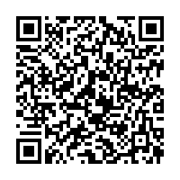
Local governance
Site research team led by PI
  NIHR Associate PI scheme: a six month in-work training opportunity, practical experience for trainees
Local information pack and ISF documents provided electronically

Slide 15
Agenda
Background and trial design
Governance
Patient flow
Support/resources

Slide 16
Patient flow diagram
Screening
Randomisation
IV sodium bicarbonate, 8.4% w/v
No sodium bicarbonate
Safety monitoring
Data collection
Consent
Follow-up

Slide 17
Patient flow diagram
Screening
Randomisation
IV sodium bicarbonate, 8.4% w/v
No sodium bicarbonate
Safety monitoring
Data collection
Consent
Follow-up

Slide 18
Inclusion criteria
Patients admitted to critical care units fulfilling the below, at any point during the critical care unit stay:
Adult (aged ≥18 years)
Metabolic acidosis (arterial blood gas values of pH <7.30 and PaCO₂ <6.5 kPa)
AKI – KDIGO stage 2 or 3, defined as any one of the following three criteria:
  Serum creatinine ≥2.0 times baseline
  or
  Serum creatinine ≥354 µmol/L, AND either a rise of ≥27 µmol/L within 48 hours or serum creatinine ≥1.5 times baseline
  or
  Urine output of <0.5 ml/kg/h for ≥12 hours

Slide 19
Baseline serum creatinine value
If available, use pre-hospitalisation value within 365 days of current hospital admission date
If multiple pre-hospitalisation values, use the one closest to the date of current hospital admission
If a pre-hospitalisation value from the 365 days prior to admission date is not available and there are multiple values from the current hospitalisation prior to the onset of the acute illness, then use the lowest one from the current hospitalisation
If no baseline value is available, then estimate it using the provided calculator (see next slide)

Slide 20
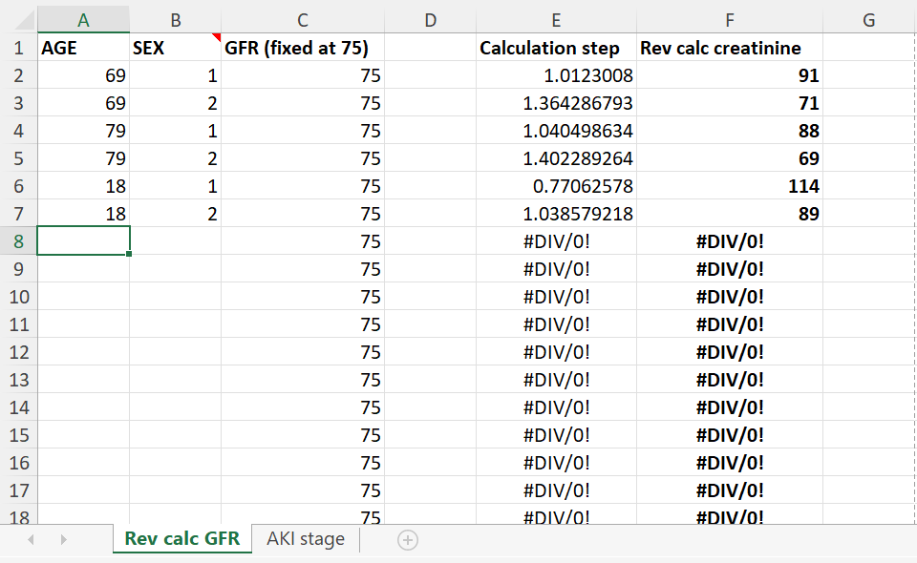
Baseline serum creatinine - calculator
Estimated baseline serum creatinine will appear in column F
Enter patient’s age and sex (1=Male, 2=Female)

Slide 21
Exclusion criteria – (Protocol v4.2)
If corrected, patient may be reconsidered for trial
Respiratory acidosis (acute or chronic)
KRT immediately indicated and treating clinician(s) unwilling to defer if randomised to sodium bicarbonate
Deemed unsuitable for KRT
High output stoma/ileostomy
Percutaneous biliary drainage
End stage kidney failure defined as documented eGFR<15 ml/min/1.73m² prior to onset of this acute illness or end stage kidney disease (ESKD) on dialysis
Known renal tubular acidosis
Diabetic ketoacidosis
High anion gap acid poisoning (e.g. PEG, aspirin, methanol)
Symptomatic hypocalcaemia (Ionised calcium <1.05 mmol/L)*
Hypernatraemia (Plasma sodium >150 mmol/L)*
Severe hypokalaemia (Potassium <3.0 mmol/L)*
Death perceived as imminent
Known hypersensitivity to IMP or excipients
Previously randomised into MOSAICC
Intended to exclude those with pre-existing kidney failure or on long-term chronic dialysis

Slide 22
FAQs
How do you assess whether hypocalcaemia is symptomatic in an intubated and ventilated patient?
It is difficult to assess whether a patient is symptomatic when intubated and ventilated. If the hypocalcaemia was found incidentally, the patient is not being treated clinically for hypocalcaemia, and the treating clinician would be happy to administer sodium bicarbonate then they do not meet this exclusion criteria.
Please clarify the ‘kidney replacement therapy (KRT) immediately indicated and treating clinician(s) unwilling to defer if randomised to sodium bicarbonate’ exclusion criterion.
This exclusion should only be applied to patients where there is an immediate indication for KRT which cannot be delayed (suggested criteria in section 4.5.3 of the protocol). Otherwise, enrolment into the trial should be considered.

Slide 23
FAQs
Specified time limit between meeting eligibility and randomisation?
  No, but sites encouraged to randomise ASAP once eligibility has been confirmed
  Patients should meet all inclusion criteria and no exclusion criteria at the point of randomisation
Who can confirm eligibility?
  A doctor, medical practitioner or nurse, as long as they are appropriately qualified, have undergone study training and are signed off on the Delegation Log for this task by the PI
  Must still be overall oversight by a medically qualified doctor

Slide 24
Screening & randomisation
Screen all patients admitted to ICU with:
  AKI – KDIGO stage 2 or 3
Aim to embed screening within routine clinical practice
Coverage for out-of-hours randomisations
  Clinical staff training and engagement
  Associate PI could help with this

Slide 25
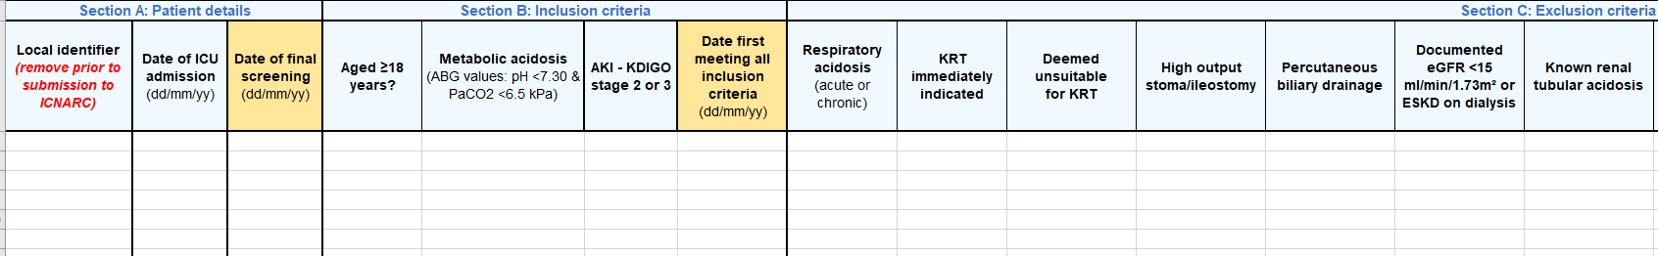
Screening & Enrolment Log
Screening Log – first tab
  Record patients admitted to ICU with AKI – KDIGO stage 2 or 3
  Each row represents a patient admission
  Complete Section B (Inclusion criteria)
  Section C (Exclusion Criteria) only needs to be completed if the yes is selected for all inclusion criteria

Slide 26
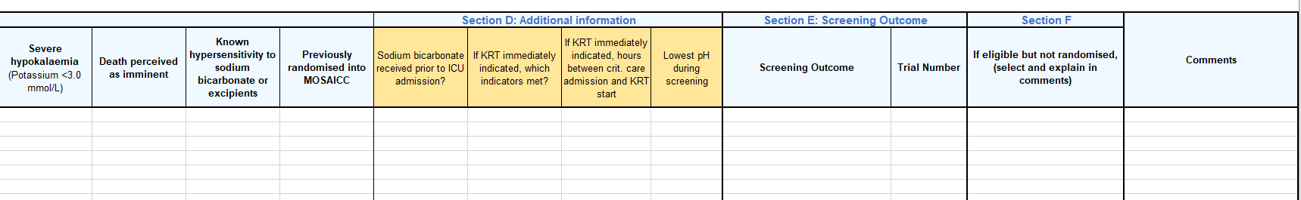
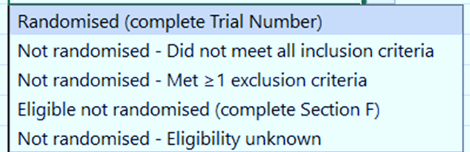
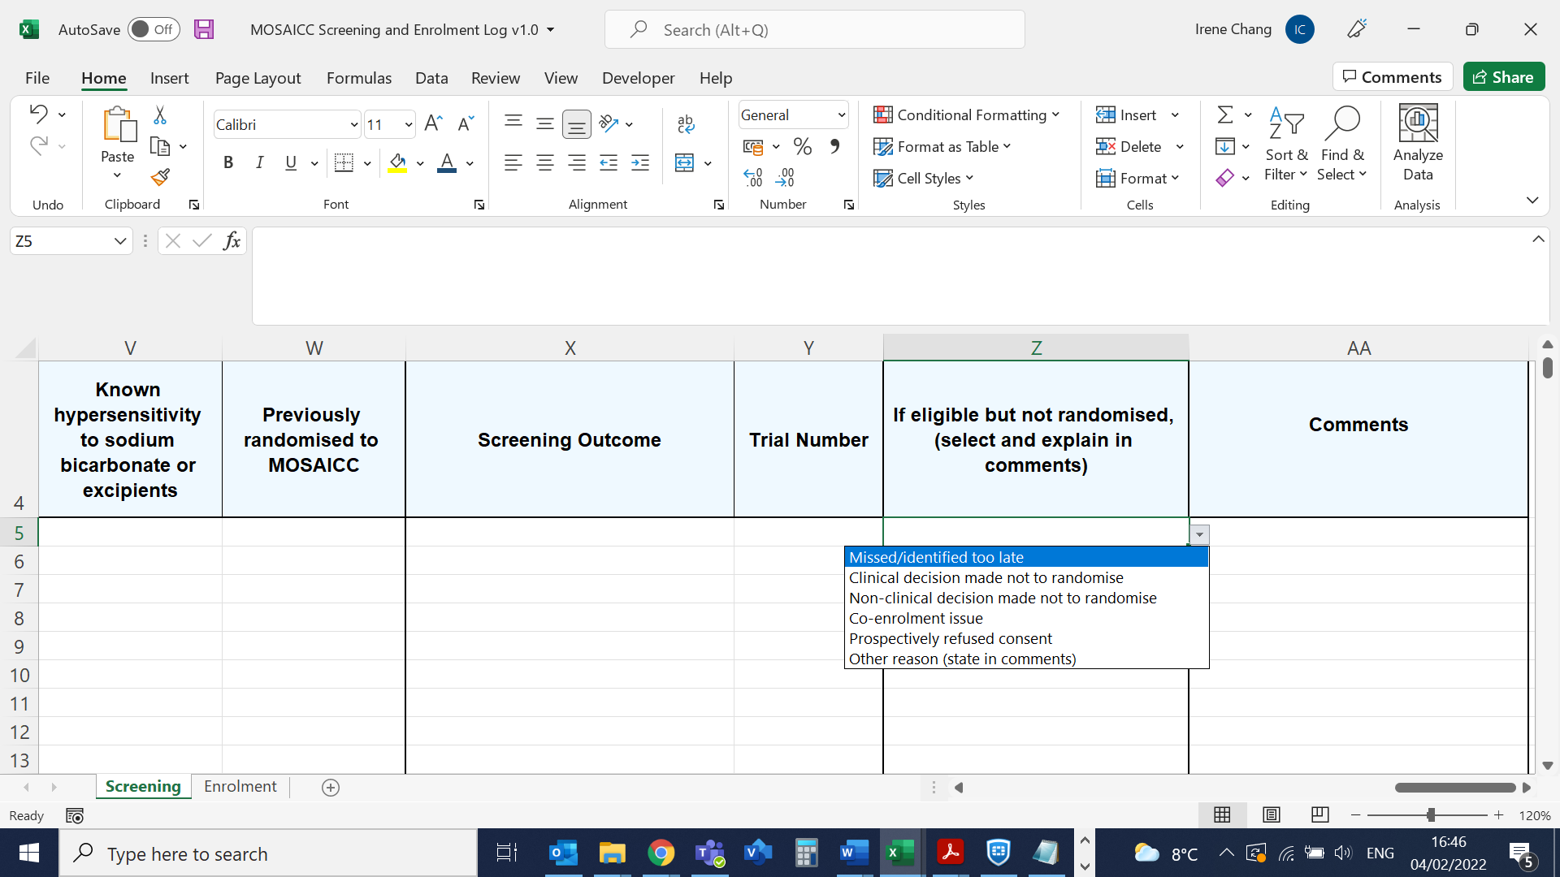
Screening & Enrolment Log
Section D is additional information
Complete Screening Outcome and section F if Eligible but not randomised

Slide 27
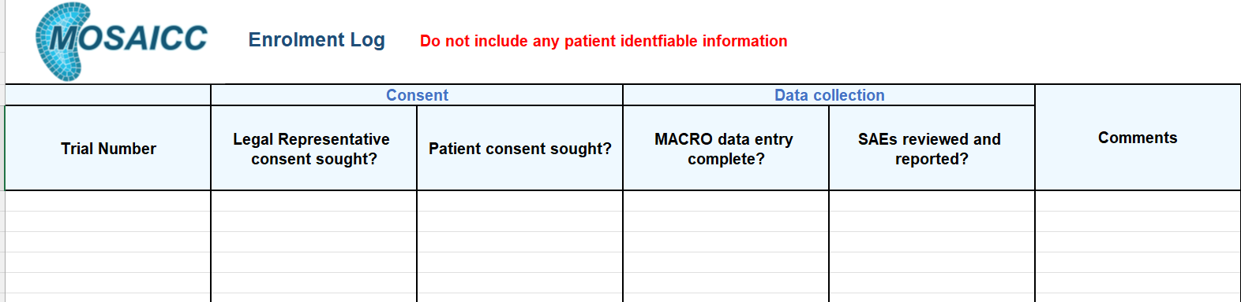
Screening & Enrolment Log
Enrolment Log – second tab
  Helps keep track of actions required for each randomised patient
Submit excel file fortnightly to ICNARC CTU
  email to mosaicc@icnarc.org
Do not submit
any identifiable information

Slide 28
Co-enrolment
Observational studies (including those collecting samples)
  Permitted without prior agreement
Interventional studies
  Decided case-by-case by TMG
  Co-enrolment acceptable with:
        ABBRUPT
        ADAPT-SEPSIS
        A-STOP
        ABC POST ICU
        BLING III
        EMERALD
        MARCH
        GENOMICC
        HARMONICS
        IRehab
        PRONTO
        RECOVERY
        SHORTER
        T4P
        UK-ROX
        VITDALIZE

Slide 29
Patient flow diagram
Screening
Randomisation
IV sodium bicarbonate, 8.4% w/v
No sodium bicarbonate
Safety monitoring
Data collection
Consent
Follow-up

Slide 30
Randomisation
Dedicated 24/7 web randomisation service
  Can use generic/group or individual email addresses
  Auto-generated randomisation notification emails
  Email mosaicc@icnarc.org to request an account and add recipients
Signed off on Training and Delegation Logs
  GCP training not required
Randomisation Form
  A hard copy must be completed and signed off for each patient at the point of randomisation

Slide 31
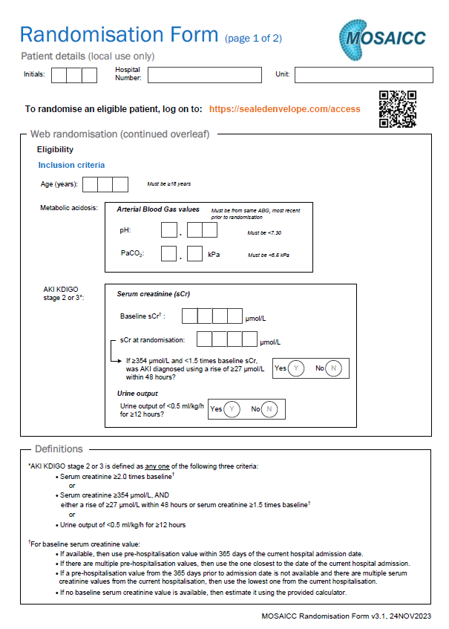
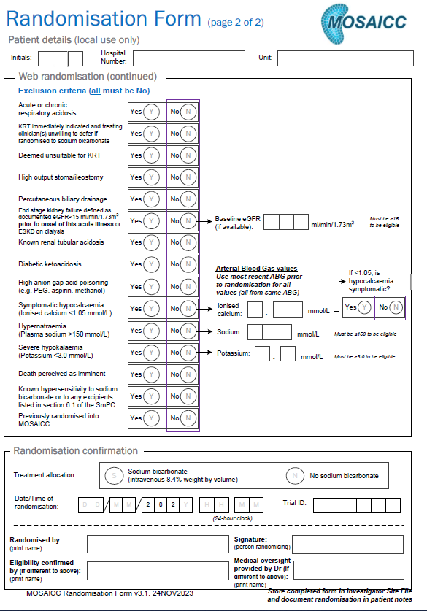

Slide 32
Randomisation
Errors
  Once randomised, patient is in trial and included in the analysis (unless a duplicate)
    Patient should continue with the randomised treatment (unless deemed clinically inappropriate)
    Consent and data collection must be carried out per protocol
  If patient accidentally randomised twice, use first randomisation
    Check email notification if unsure of the status of a randomisation
    (or contact local team/ICNARC CTU)
    Do not re-use the second randomisation details

Slide 33
FAQs
What if a patient has received sodium bicarbonate prior to randomisation?
  This is not an exclusion. If they still meet eligibility criteria, they can be randomised
  Record volume of sodium bicarbonate received in the 24 hours prior to randomisation in the CRF
Specified time limit between randomisation and first dose of sodium bicarbonate?
  No, but first dose should be given as soon as possible after randomisation

Slide 34
Patient flow diagram
Screening
Randomisation
IV sodium bicarbonate, 8.4% w/v
No sodium bicarbonate
Safety monitoring
Data collection
Consent
Follow-up

Slide 35
Intervention period
Begins immediately following randomisation
Intervention will continue until discharge from critical care, initiation of KRT or 90 days, whichever comes first
  If patient is discharged and readmitted to ICU, treatment will be at the discretion of clinical staff

Slide 36
Sodium bicarbonate, intravenous 8.4% w/v
Aiming to restore pH to ≥7.30
Any brand with marketing authorisation in the UK may be used
Trial-specific labelling is not required
Dispensed in accordance with a prescription (prn up to a max daily dose of 500ml/24 hours)
Arterial blood gas should be performed 1-2 hours after each infusion
Dosage schedule | 50 ml administered over 30-60 minutes
Maximum daily dose | 500 ml / 24 hours

Slide 37
Intervention flow diagram
Randomisation
IV 8.4% w/v sodium bicarbonate*
No sodium bicarbonate*
Repeat sodium bicarbonate
infusion,
up to a max daily dose of 500ml/24hrs*
ABG 1-2 hrs
post-infusion
pH < 7.30
pH ≥ 7.30
Monitor pH for duration of critical care unit stay, initiation of KRT or 90 days, whichever comes first
pH < 7.30
pH ≥ 7.30
37

Slide 38
FAQs
IMP given centrally or peripherally?
  Ultimately depends on your Trust guidelines but the investigators agree 8.4% w/v sodium bicarbonate would usually be given centrally, though a dose in an emergency could initially be delivered peripherally
  If the patient is otherwise eligible but does not have central access and no plans for it for their care, then record this patient as ‘Eligible not randomised’ and document the reason on the screening and enrolment log

Slide 39
FAQs
Do prescribers need to be GCP trained if they are only going to prescribe?
  If prescribing is part of their job, they will not require GCP
  However, they will have to have undergone training in the study protocol and procedures and be signed off on the Training Log

Slide 40
Kidney Replacement Therapy (KRT)
*Indications to commence KRT may develop following randomisation
Initiation is at the discretion of the treating clinician
As a guide, KRT may be considered where at least two of the following criteria are present:
  Urine output <0.3 mL/kg/h for at least 24 hours
  Arterial pH <7.25 despite adequate volume resuscitation, or in the intervention group an arterial pH <7.25 after adequate administration of sodium bicarbonate (defined as sodium bicarbonate treatment for 24 hours or administration of the maximum 500ml/24 hours, as per algorithm)
  Hyperkalaemia (serum potassium >6.5 mmol/L)
  Fluid overload intractable to diuretics

Slide 41
Initiation of KRT
If clinician decides to initiate KRT for participant:
  Complete the Initiation of KRT CRF:
    Date/time of decision
    Reason initiated
    Physiology at decision
    KRT details

Slide 42
FAQs
In the intervention flow, if pH≥7.30 we should monitor pH for duration of critical care stay. If a patient is on ICU for several weeks, we often remove their arterial lines during convalescence – is a venous gas okay?
  Yes, a venous gas is acceptable
  Blood gas values are collected:
    6-hourly from Day 1 (from time of randomisation) to Day 5
    Daily from Day 6+ (record values from the first blood gas after the standard unit charting time)

Slide 43
Training
Ensure staff are aware of trial and intervention algorithm and that they may be managing intervention group patients
  Including temporary/bank/agency staff
Ensure clear documentation of dosing and proper handover to subsequent shifts
Discussion point at ward rounds
Use stickers/labels

Slide 44
Patient flow diagram
Screening
Randomisation
IV sodium bicarbonate, 8.4% w/v
No sodium bicarbonate
Safety monitoring
Data collection
Consent
Follow-up

Slide 45
No sodium bicarbonate
All treatment determined by treating clinician
Protocol deviations
If clinician decides to initiate KRT for participant:
  Complete Initiation of KRT CRF
If a patient randomised to no sodium bicarbonate receives sodium bicarbonate, please record volume received on the CRF and provide a reason in the Comments box
Document in file note

Slide 46
Patient flow diagram
Screening
Randomisation
IV sodium bicarbonate, 8.4% w/v
No sodium bicarbonate
Safety monitoring
Data collection
Consent
Follow-up

Slide 47
Research Without Prior Consent
Patients may lack capacity at time of randomisation
In the UK, the law allows adults not able to consent for themselves to be recruited into CTIMPs without prior consent in emergency situations if:
  treatment needs to be given urgently
  it is also necessary to take urgent action to administer the IMP for the purposes of the trial
  it is not reasonably practicable to obtain consent from a legal representative
  the procedure is approved by a NHS Research Ethics Committee
  consent is sought from a legal representative as soon as possible.

Slide 48
Consent procedures
After randomisation and once patient’s medical situation is no longer considered an emergency, consent procedures should begin
  Consent sought by GCP-trained team member
    Adults Lacking Capacity module highly recommended
  Expected to be within 24-48 hours of randomisation

Slide 49
Consent procedures
In rare situation where patient has capacity:
seek written or verbal/other non-written consent
to randomise if appropriate,
otherwise consent is deferred
Patient confirmed eligible
49

Slide 50
Consent procedures
Approach patient for consent
Once medical situation is no longer an emergency
(around 24-48 hours after randomisation)
If patient has capacity
Patient confirmed eligible
Approach Personal Legal Representative (in person/telephone)
Randomisation
If patient lacks capacity
Seek written/verbal/
other non-written
consent, if appropriate
If patient lacks capacity and there is no Personal Legal Representative OR
if patient has died
Approach Professional Legal Representative

Slide 51
Personal Legal Representative
If patient lacks capacity, approach Personal Legal Representative
  Relative/close friend - not restricted to next of kin
Advises on patient’s likely wishes/feelings regarding participation in the trial
Approach:
  In person (preferred)
    Give Personal Legal Representative Information Sheet and Consent Form
  Telephone (if unable to visit)
    Offer to send Personal Legal Representative Information Sheet via email/post
    Complete Telephone Personal Legal Representative Consent Form
    Must be witnessed

Slide 52
Professional Legal Representative
Approach Professional Legal Representative if:
  Patient lacks capacity and no Personal Legal Rep is available/willing
  Patient has died
Can include:
  Doctor independent of the trial (not on Delegation/Training Log)
  Person nominated by the NHS Hospital Trust
Purpose:
  to advise on patient’s likely wishes/feelings regarding participating in the trial
  to reduce stress on grieving relatives

Slide 53
Patient informed consent
Upon recovery, patient should be approached directly
  Give Patient Information Sheet
  Approach with Consent Form
    Explain consent options
If patient wishes to have more time or is discharged, approach by telephone/post after discharge
  Complete Telephone Consent Form
  Must be witnessed
Patient’s decision is final

Slide 54
Explaining the trial
Information should be clear, concise and not medicalised
Explain:
  why we are doing the trial
  why consent cannot be sought in emergency situations
  explain sodium bicarbonate and KRT in lay terms
Allow time to think about the trial, discuss with friends/family and ask questions

Slide 55
Completion of consent forms
Signing indicates agreement with points 1-5
Points 6-7 (follow-up and anonymised data sharing) should be initialled if in agreement
  Optional but should be encouraged
Patient/Legal Rep. completes first, then person seeking consent checks form is completed correctly and countersigns in their presence
If patient unable to physically sign the form, an independent witness may sign on their behalf
A copy given to the patient/Legal Rep., a copy for medical notes and original stored in ISF

Slide 56
FAQs
Who can approach for consent?
  Authorised staff members who have received training in MOSAICC processes and procedures, are trained in GCP and have been signed off on the Delegation Log by the PI
  Can include doctors, nurses, other allied health professionals and research/clinical trial practitioners
  PI retains overall responsibility for the informed consent of participants at their site and must ensure that any person delegated this responsibility is adequately trained

Slide 57
Refusals and Withdrawals
If patient/Legal Representative declines or withdraws consent, clarify which aspects they are declining/withdrawing from
  Total vs. partial - may be willing to allow continued data collection (must be documented)
  Not obliged to provide a reason
Data on events occurring up to refusal/withdrawal retained in trial, unless patient/Legal Representative requests otherwise
To monitor non consent, details should be added to MACRO

Slide 58
Patient flow diagram
Screening
Randomisation
IV sodium bicarbonate, 8.4% w/v
No sodium bicarbonate
Safety monitoring
Data collection
Consent
Follow-up

Slide 59
Safety monitoring
From randomisation until critical care unit discharge or 90 days (whichever comes first)*
Adverse Events (AEs)
Specified
  Alkalosis (ABG value of pH≥7.55)
  Hypokalaemia (Potassium <3.2 mmol/L)
  Hypernatraemia (Plasma sodium >150 mmol/L)
  Hyperosmolarity (Serum osmolarity >300 mOsm/L)
  Hypocalcaemia (Ionised calcium <1.05 mmol/L)
  Hypoglycaemia (Blood glucose <3.5 mmol/L)
Deterioration of hemodynamic status associated with volume overload
Extravasation
Tissue necrosis caused by incorrect administration (intra-arterial, paravenous)
Adverse Reactions (ARs) - judged as having a reasonable suspected causal relationship (possibly, probably, definitely) to study drug)
  Record from the time of first dose of sodium bicarbonate until 24 hours after the final dose
*If readmitted to ICU within 90 days, safety monitoring will be recommenced

Slide 60
Safety monitoring
Non-specified
  Non-specified ARs should be recorded on the CRF
  Non-specified AEs will only be recorded/reported if they are assessed to be serious

Slide 61
Safety reporting
Serious Adverse Events (SAEs)
  If severity of AE is severe, life threatening or fatal
  Report on SAE Reporting Form
  Upload to MACRO
  Notify ICNARC CTU of upload by emailing mosaicc@icnarc.org
    within 24 hours of becoming aware of the event
  Enter data onto MACRO database

Slide 62
Safety monitoring
All AEs/SAEs judged as having a reasonable suspected causal relationship (e.g. possibly, probably, definitely) to the study drug will be considered as ARs/SARs
SUSAR: a serious adverse reaction, the nature and severity of which is not consistent with the information in the SmPC
  Reporting requirements to the MHRA:
    Fatal/life threatening → within 7 days of first becoming aware
    Non-fatal/non-life threatening SUSARs → within 15 days
To assess expectedness, refer to section 4.8 of the SmPC

Slide 63
Patient flow diagram
Screening
Randomisation
IV sodium bicarbonate, 8.4% w/v
No sodium bicarbonate
Safety monitoring
Data collection
Consent
Follow-up

Slide 64
Data collection
For adherence, in-hospital outcomes, AEs/ARs
Other data to be obtained from national sources:
  Case Mix Programme, NHS Digital, UK Renal Registry
All randomised patients must be added to MACRO database: https://ctu.icnarc.org/macro/
  Submit Research Staff Contacts Form to mosaicc@icnarc.org
  (list all who need an account)
  Individuals must be signed off on Delegation Log and GCP trained
MACRO training session recording on website
CRF Guide

Slide 65
65

Slide 66
Enter details of first sodium bicarbonate infusion, which should be administered ASAP following randomisation.
If it was not given, then complete deviation form and begin active monitoring.
66

Slide 67
ABG analysis should be performed 1-2 hours after each infusion
67

Slide 68
Patients randomised to intervention will receive sodium bicarbonate aiming to restore pH to ≥7.30 for the duration of the critical care unit admission or until initiation of KRT
68

Slide 69
‘No’:
If pH ≥7.30, then do not give sodium bicarbonate and continue active monitoring.
*If pH <7.30 and sodium bicarbonate was not given, then complete deviation form.
‘Yes’:
If pH <7.30, then give sodium bicarbonate.
*If pH ≥7.30 and sodium bicarbonate was given, then complete deviation form.
69

Slide 70
Monitor pH for duration of critical care stay or until initiation of KRT
‘Yes’ if pH dropped <7.30 or if sodium bicarbonate was given. Follow the arrow to complete the Assessment ABG values and infusion details to the right
‘No’ only if KRT initiated, or if patient has been discharged from the critical care unit. Complete Initiation of KRT (if applicable) and Outcome CRFs
Once all details are completed, please initial
69

Slide 71
Protocol deviations
If pH <7.30 and sodium bicarbonate was not given, or if pH ≥7.30 and sodium bicarbonate was given, then complete deviation form in CRF and provide reason

Slide 72
Patient flow diagram
Screening
Randomisation
IV sodium bicarbonate, 8.4% w/v
No sodium bicarbonate
Safety monitoring
Data collection
Consent
Follow-up

Slide 73
Questionnaire follow-up
At 90 days and 12 months
  EuroQol Health questionnaire (EQ-5D-5L)
  Health services and resource use questionnaire
Questionnaire sent to patient at time point by ICNARC
Non-responders called to check if received
If an inpatient at 90 days, site asked to approach patient to complete questionnaire in person

Slide 74
Agenda
Background and trial design
Governance
Patient flow
Support/resources

Slide 75
Support/resources
Site Initiation Visits
Site Zoom/Teams calls
Routine Monitoring Visits
Regular recruitment updates
Training sessions
CRF and Consent guidance documents
Bedside summary sheet
Posters
Certificate templates
Labels/stickers
Pens / Notepads
…let us know if you have any other ideas!

Slide 76
Local resources
Direct research costs from ICNARC
  Start-up fee (on randomisation of first patient): £250
  Per eligible patient randomised and approached for consent: £175
  Close-down: £250
Each invoice must quote a unique PO number, requested in advance from mosaicc@icnarc.org
Adopted on NIHR Portfolio (49697)

Slide 77
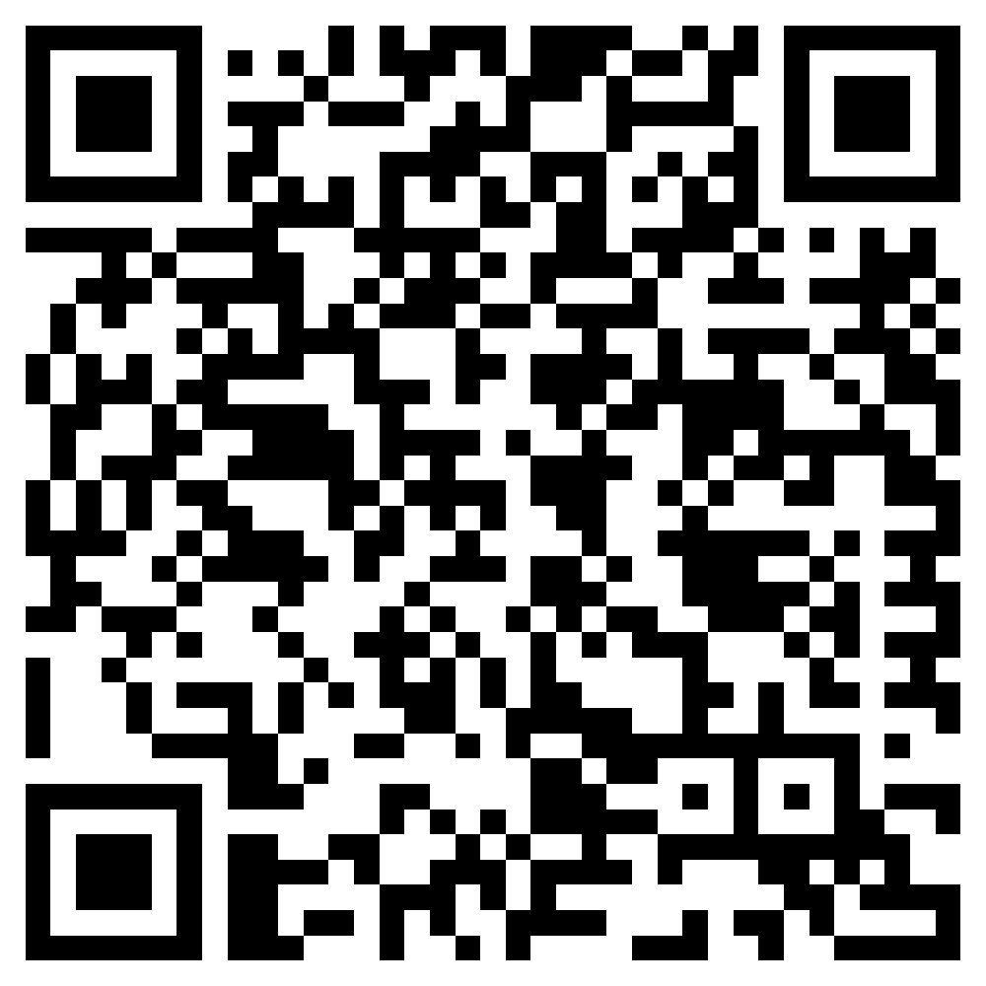
Things we need from you
Prior to site activation:
  Local training and awareness raising
  Confirmation of capacity and capability
  Signed study agreement
  Delegation and Training Logs
  Research Staff Contacts Form
  PI Statement and CV
  GCP certificates
  Confirm screening start date
Before/following activation:
  ISF checklist
  Screening and Enrolment Log
ISF available for download: https://www.icnarc.org/Our-Research/Studies/Current-Studies/MOSAICC/Information-for-sites/Site-Setup/ISF

Slide 78
Lead Investigators ICNARC CTU Team
Catherine Oversby (Trial Manager)
Hayley Noble (Trial Manager)
Julie Camsooksai (Clinical Research Assistant)
Lizzy Iroajanma (Research Assistant)
Irene Chang (Trial Manager)
Tina Reetun (Trial Monitor)
Carly Au (Senior Data Manager)
Julia Edwards (Trial Statistician)
James Doidge (Senior Statistician)
Doug Gould (Senior Researcher)
Paul Mouncey (Head of Research)
Sponsor Representative
Kate Threapleton (Clinical Trials Manager)
Lui Forni (Chief Investigator)
Nick Selby (Chief Investigator)
James Doidge (Senior Statistician)
Doug Gould (Senior Researcher)
David Harrison (Head Statistician)
Luke Hodgson (Consultant)
Kathy Rowan (CTU Director)
Zia Sadique (Health Economist)
Manu Shankar-Hari (Professor)
Michael Wise (Patient representative)
Kelly Wright (Lead AKI Nurse)

Slide 79
Questions for you
Does your Trust require that only clinicians confirm eligibility/consent?
How do you envision screening working at your site?
And a reminder:
If a patient is transferred, please let us know.

Slide 80

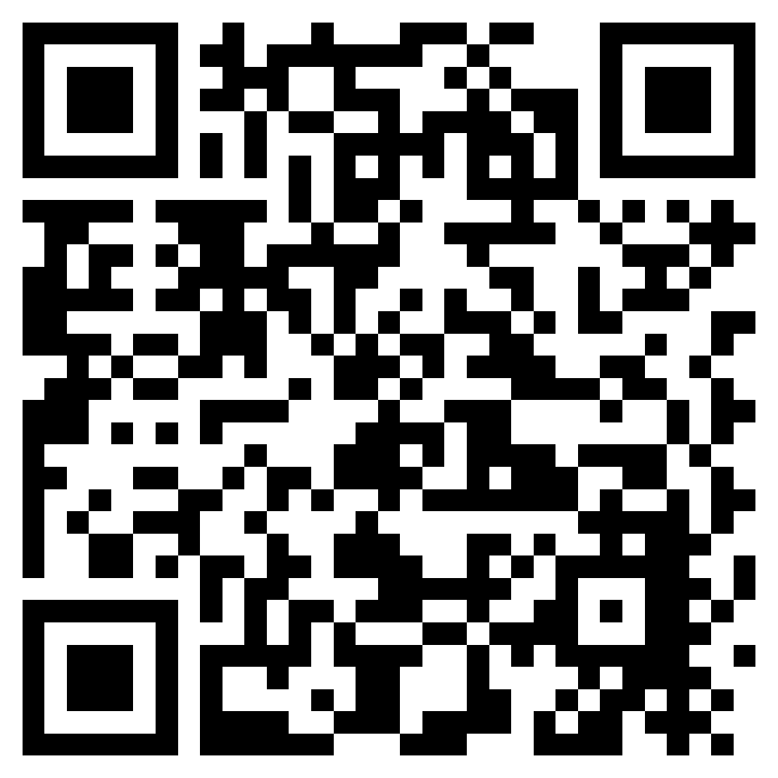
Thank you!
Any questions?
mosaicc@icnarc.org
020 7831 6878
https://www.icnarc.org/Our-Research/Studies/Current-Studies/MOSAICC/home

